Slide 1
Scholarships
Gift money for educational expenses that you don’t have to pay back.

Slide 2
Types of Scholarships
Merit-based:
Awarded based on academic performance, talents and leadership abilities.
Need-based:
Awarded to those that demonstrate financial need.

Slide 3
Start your search early.
Gather materials
Schedule time
Use checklists
Set a reminder.

Slide 4
Documents you will need:
Transcripts
Letter of Rec
Personal Essay
Copy of Your SAR
Not all scholarships will require these things.

Slide 5
What to look For:
Letter of Recomendation
How many?
Who to ask?
Submission type? (online, PDF, or paper)
Use WHS’s LOR packet
Give teacher/counselor 3-4 weeks notice
Transcripts
Unofficial (most) or official?
Other materials
Resume?
Activity Sheet?
Project? (video, art, science project)
Eligibility: Do you qualify?
Online or paper application?
Deadlines:
Postmark or submission date?
Essay
Read through the entire application.
Answer the question.
Length requirements?
In app or a separate document?

Slide 6
Set up a schedule to search & complete applications
Use a scholarship tracker worksheet to stay organized.
Available on the WHS C&C website.

Slide 7
How to find scholarships?
Naviance
student.naviance.com/windsorhigh

Slide 8
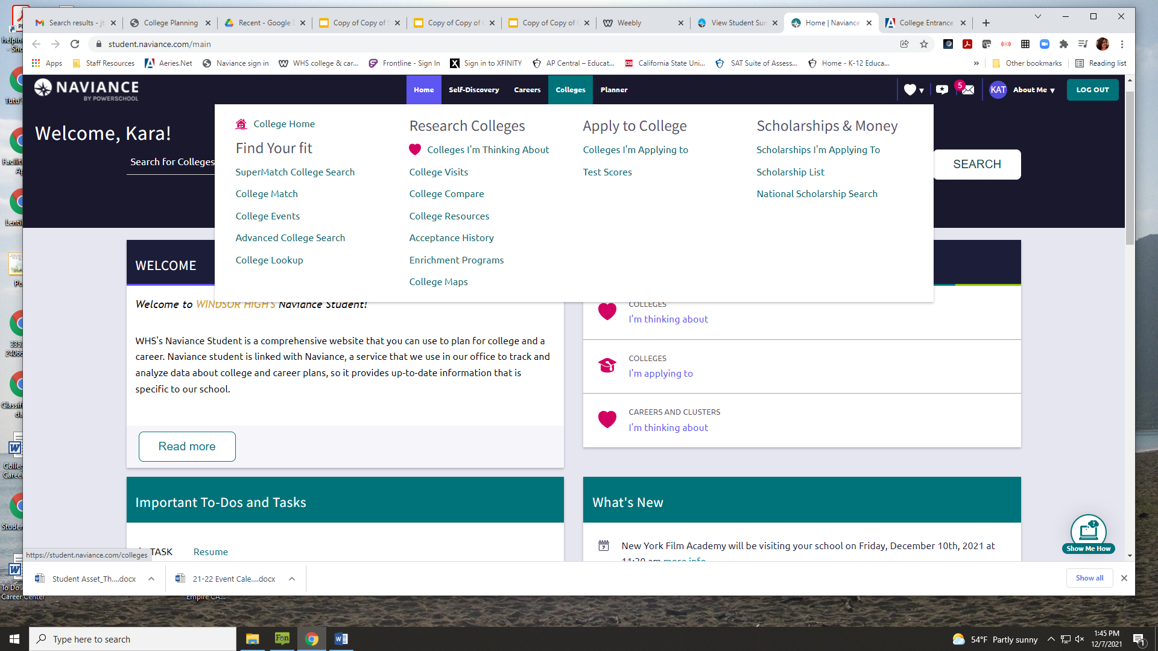

Slide 9
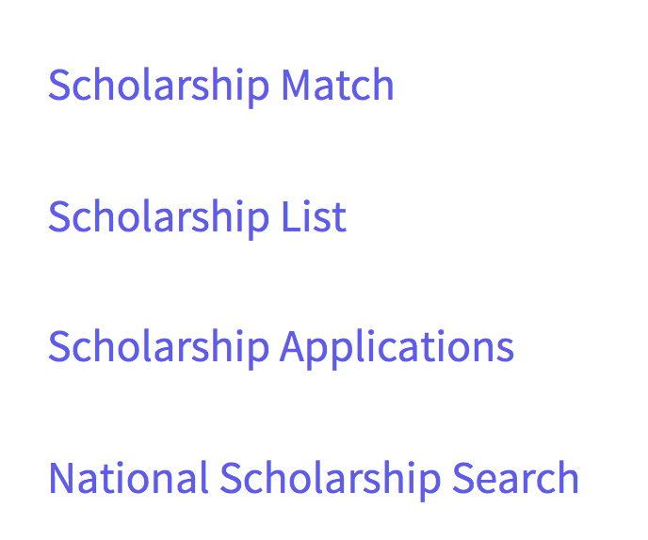
Two Different lists
Local, regional, and other scholarships added by the Coordinator as they are updated, shared, or discovered.
CHECK OFTEN!
National scholarship list provided by Naviance. Can narrow the selection based on criteria questions.

Slide 10
Where else to look?
Check out the college’s scholarship list on their campus website.

Slide 11
Parent/Guardian workplace or other connections
Ask about scholarships through companies, unions, clubs, that your family is involved in, including grandparents.

Slide 12
Proofread All Materials Before Submitting!
Ask for assistance with your essays, resume, or other scholarship components.

Slide 13
Watch out for Scholarship Scams
WARNING: If you have to pay a fee, there’s a money back offer, or they request your SSN or credit card info, it’s a scam!

Slide 14
Don’t Forget to Thank Your Recommenders!*
*You will need to thank your donors too if you win any awards

